Slide 1
Biometric Attack
3rd Meeting
By: Roy Zohar and Roy Mezan

Slide 2
Formalities Reminder
Roy Zohar - 209896174
Roy Mezan - 319042800
Instructors:
Prof. Rita Osdachy
Dr. Orr Dunkelman

Slide 3
Schedule
Oct - Nov
Nov-Jan
Jan - Mar
Mar - May
Defining all of our data sources
Playing around with Dlib and creating faces
Running Euclidian distance from a group of faces
Results and finding enthropy
Dlib libraries, Face distributuions, Cloud computing, Data Servers.
Learning how to create faces based on output of dlib
Run using cloud computing to find the size of the face space
Concluding the results

Slide 4
What we did
We finished coding the system, so that it can run an attack from and to any database easily
We ran several attacks on different databases using different models
We ran an attack that created 50 million synthesized faces, and overall conducted 11 billion comparisons
We recorded all of our results
We met with our instructors several times, and added features that they asked for, such as being able to recover a previous run using a pseudo random seed. We also conducted experiments that they were interested in answering, such as threshold testing

Slide 5
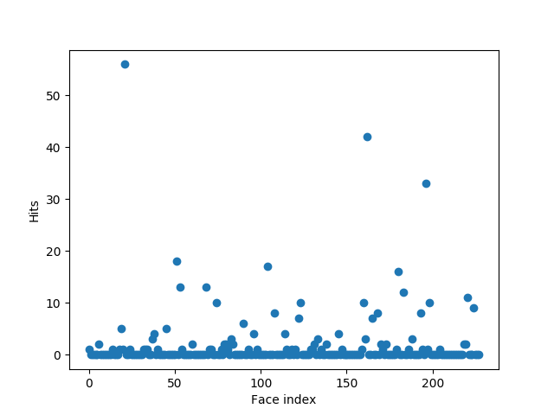
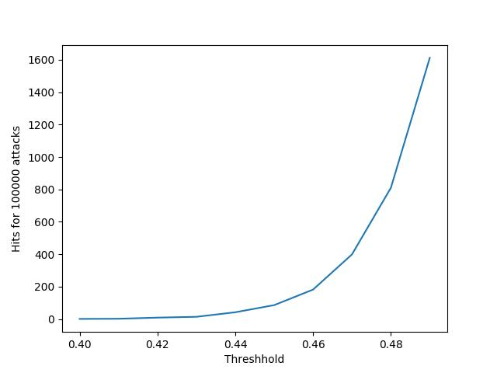
Some results

Slide 6
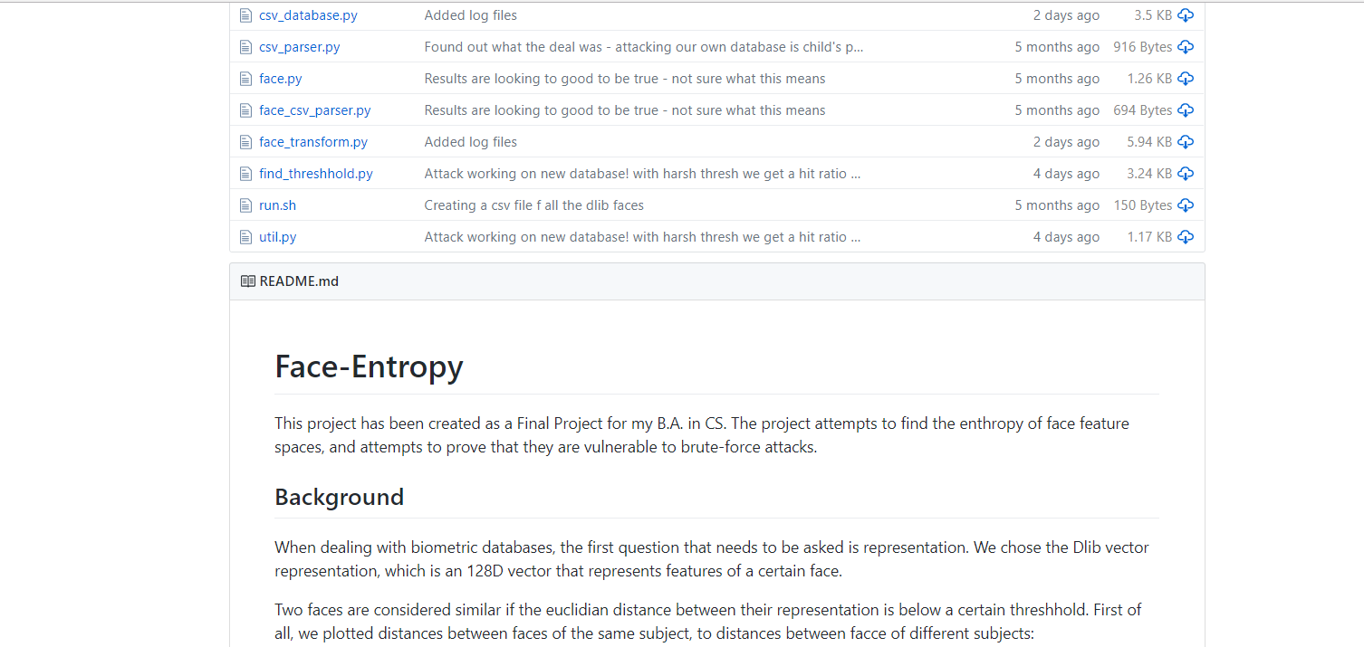
Want to see more?
https://github.com/Royz2123/Biometric-Attack

Slide 7
What’s Left?
Nothing much
Finish writing up a report that summarizes our finidings, will be done in the upcoming days

